Slide 1


Hydrodynamics for control engineers
(Module 2)
Dr Tristan Perez
Centre for Complex Dynamic Systems and Control (CDSC)
Prof. Thor I Fossen
Department of Engineering Cybernetics
One-day Tutorial, CAMS'07, Bol, Croatia

Slide 2
Marine hydrodynamics
In order to study the motion of marine structures and vessels, we need to understand the effects the surrounding fluid has on them.
This requires some basic concepts of hydrodynamics—which is fluid dynamics under special-case simplifications and assumptions particular of marine applications.
To solve problems related to ship motion we, need to know two things about the fluid:
    velocity
    pressure
One-day Tutorial, CAMS'07, Bol, Croatia

Slide 3
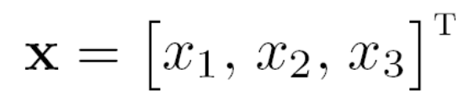
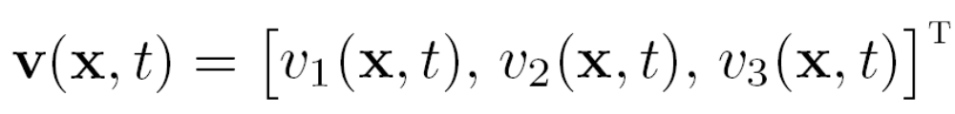
Fluid flow description
The velocity of the fluid at the location
x
v(x,t)
is given by the fluid-flow velocity vector:
this vector is usually described relative to an inertial coordinate system with origin in the mean free surface (h-frame, or s-frame).
One-day Tutorial, CAMS'07, Bol, Croatia

Slide 4
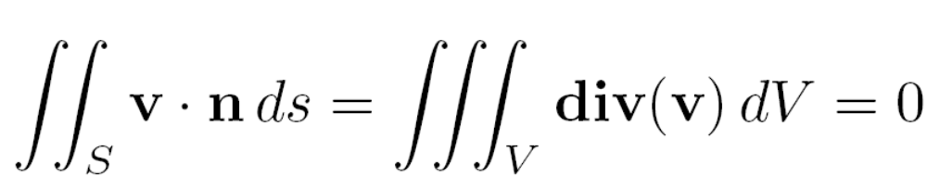

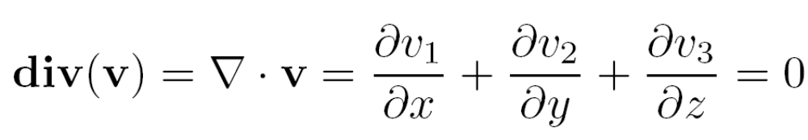
Incompressible fluid
For the flow velocities involved in ship motion, the fluid can be considered incompressible, i.e., constant density.
Under this assumption, the net volume rate at a volume V enclosed by a surface S is
since this is valid for all the regions V in the fluid, then by assuming that is continuous, we obtain the
continuity equation for incompressible flows:
One-day Tutorial, CAMS'07, Bol, Croatia

Slide 5


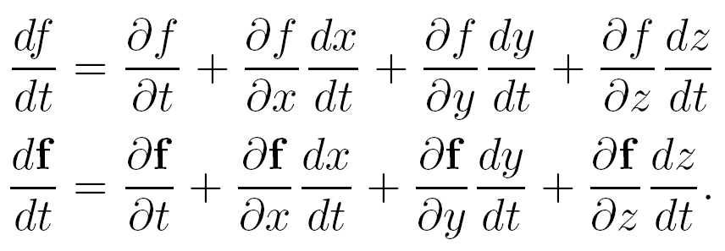

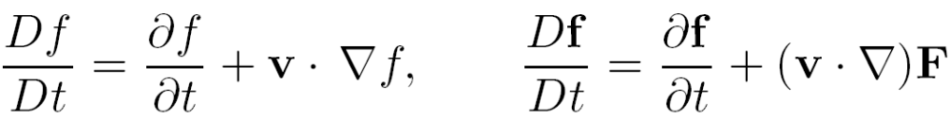
Material derivative
Let be a scalar function and a vector-valued function; then,
If these are taken for the function
then we have a special notation—material derivative:
One-day Tutorial, CAMS'07, Bol, Croatia

Slide 6
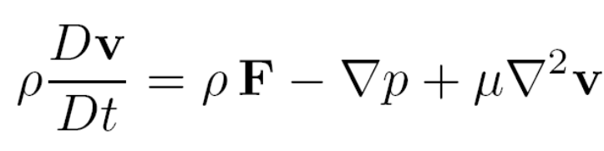
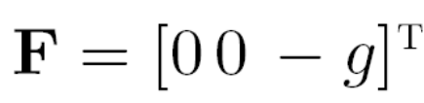
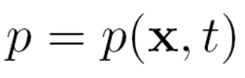
Flow equations
The conservation of momentum in the flow is described by the Navier-Stokes (N-S) Equation:
F are accelerations due to volumetric forces:
is the pressure, and μ is the viscosity of the fluid.
Unknowns: v and p
N-S + Continuity eq. form a system of Nonlinear PDE
No analytical solution exists for realistic ship flows.
Numerical solutions are still far from feasible
Practical approaches: RANS (CFD)
One-day Tutorial, CAMS'07, Bol, Croatia

Slide 7
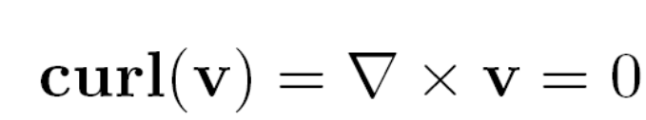

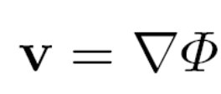
Potential theory
A further simplification is obtained by assuming that the fluid is inviscid and the flow is irrotational. Irrotaional means that
Under this assumption, then exists a scalar function called potential such that
So, if we know the potential, we can calculate the flow velocity vector (the gradient of the potential).
One-day Tutorial, CAMS'07, Bol, Croatia

Slide 8
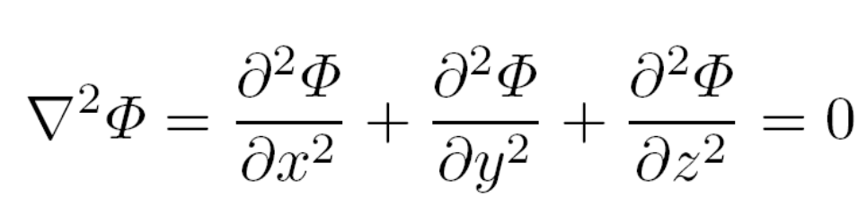
How do we obtain the potential?
In potential theory, the continuity equation reverts to the Laplacian of the potential equal to zero:
The potential is, thus, obtained by solving this subject to appropriate boundary conditions, i.e., by solving a boundary value problem (VBP).
The Laplace Equation is linear ⇔ Superposition of flows.
One-day Tutorial, CAMS'07, Bol, Croatia

Slide 9
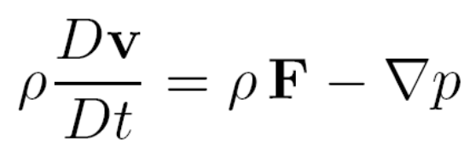
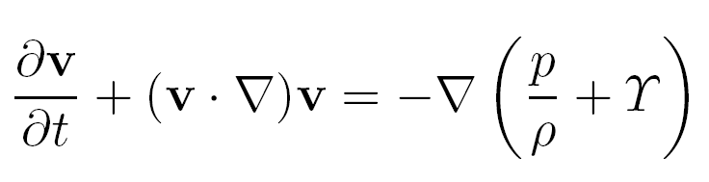

How do we calculate pressure?
If we neglect viscosity in the N-S equation, we obtain the Euler Equation of flow:
Then,
where
One-day Tutorial, CAMS'07, Bol, Croatia

Slide 10
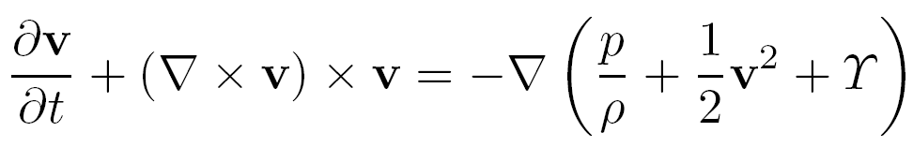
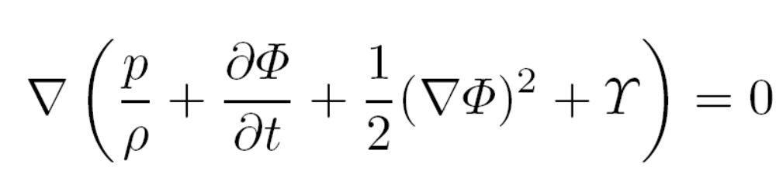
Irrotaional flow assumption
Using some vector calculus
If the flow is irrotational, then
where
One-day Tutorial, CAMS'07, Bol, Croatia

Slide 11
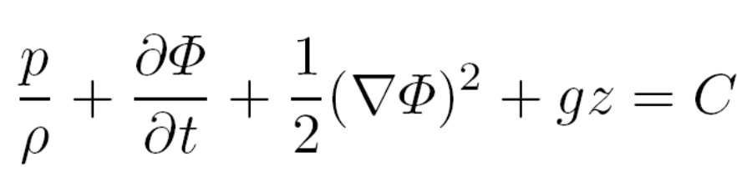
Bernoulli equation
If this is valid in the whole fluid, then
which is the Bernoulli equation.
One-day Tutorial, CAMS'07, Bol, Croatia

Slide 12
Potential theory—summary
Potential theory offers a great simplification: if we know the potential, then we know the velocity and the pressure, from which we can calculate the forces acting on a floating body by integrating the pressure over the surface of the body.
Inviscid fluid and irrotational flow
Potential
Flow velocity
Pressure
for most problems related ship motion in waves, potential theory is sufficient for engineering purposes. Viscous effects are added to the models using empirical formulae or via system identification.
One-day Tutorial, CAMS'07, Bol, Croatia

Slide 13
Applications
Regular waves
Marine structures in waves
One-day Tutorial, CAMS'07, Bol, Croatia

Slide 14
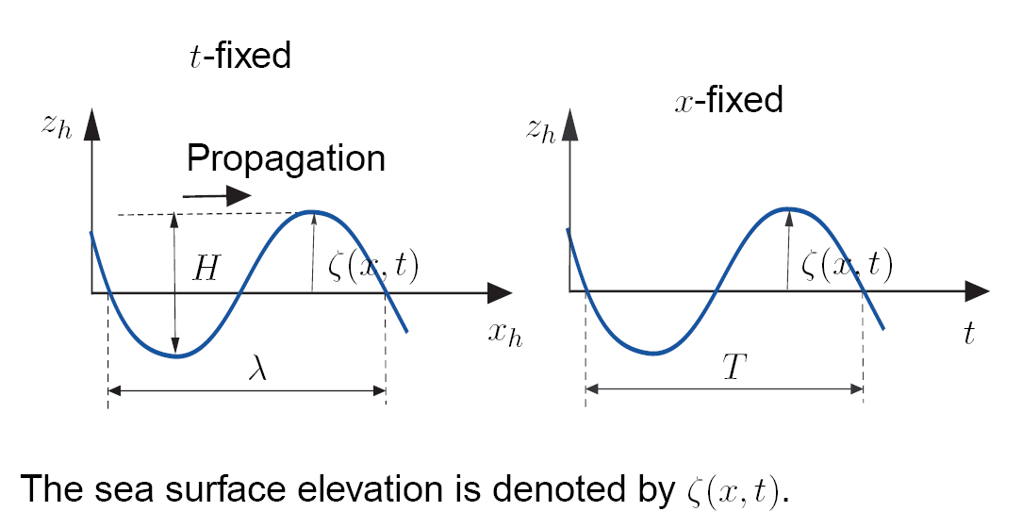
Regular waves in deep water
One-day Tutorial, CAMS'07, Bol, Croatia

Slide 15
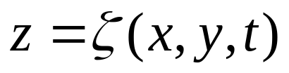

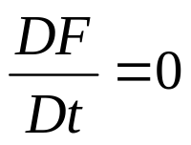
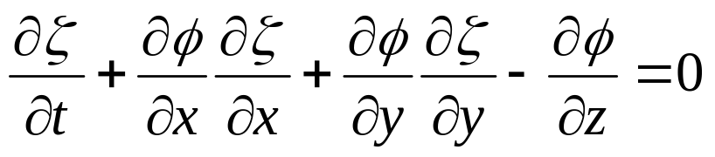
Kinematic free-surface Condition
Kinematic free-surface condition: A fluid particle on the free surface is assumed to remain on the free surface.
Let the free surface be defined as
Then, if
The kinematic condition reverts to
Hence,
on
One-day Tutorial, CAMS'07, Bol, Croatia

Slide 16
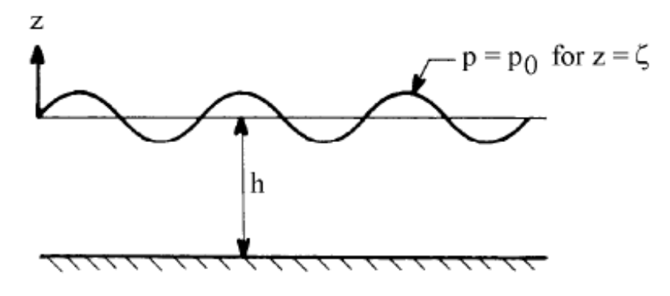

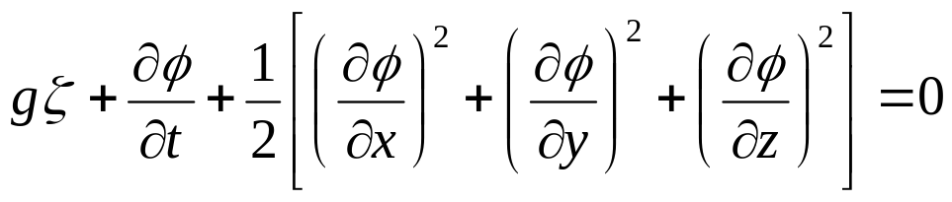

Dynamic free-surface Conditions
Dynamic free-surface condition: the water pressure equals the atmospheric pressure on the free surface.
If we choose the constant in the Bernoulli equation as
Then,
on
One-day Tutorial, CAMS'07, Bol, Croatia

Slide 17
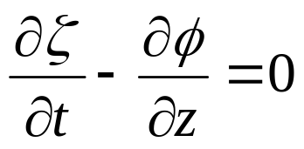

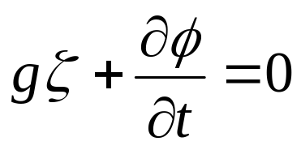
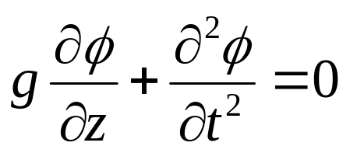
Linearised free-surface conditions
The free-surface conditions can be linearised about the mean free-surface:
on
Combined:
on
One-day Tutorial, CAMS'07, Bol, Croatia

Slide 18
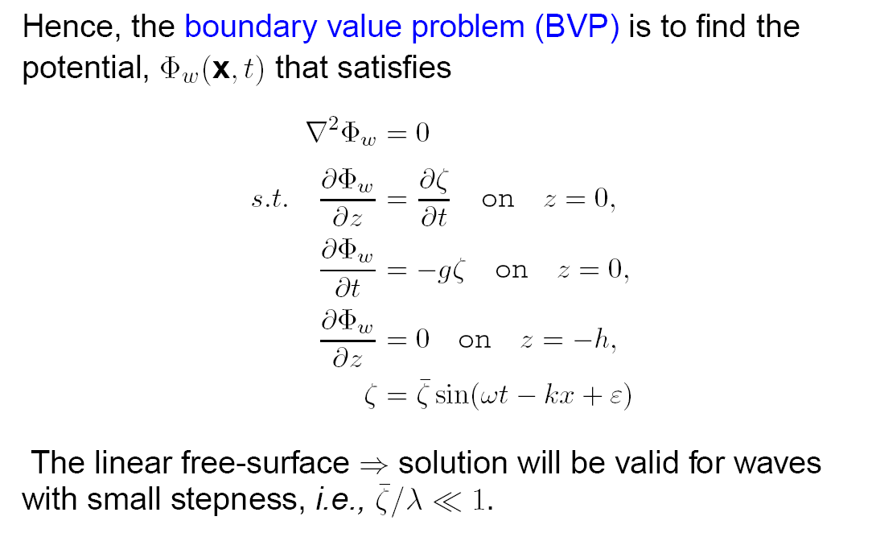
Regular Wave linear BVP
One-day Tutorial, CAMS'07, Bol, Croatia

Slide 19
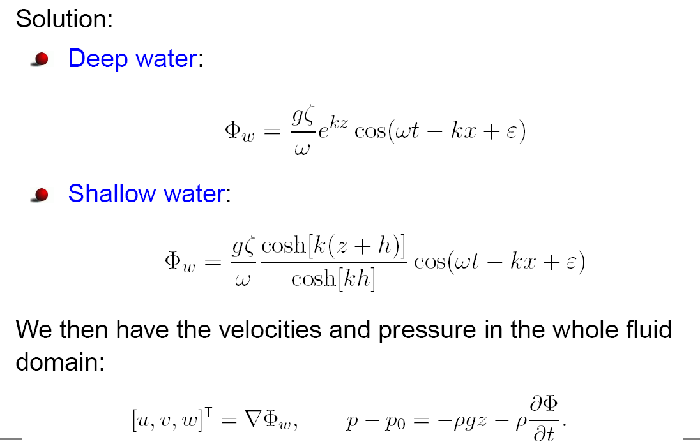
Regular Wave Potential
One-day Tutorial, CAMS'07, Bol, Croatia

Slide 20
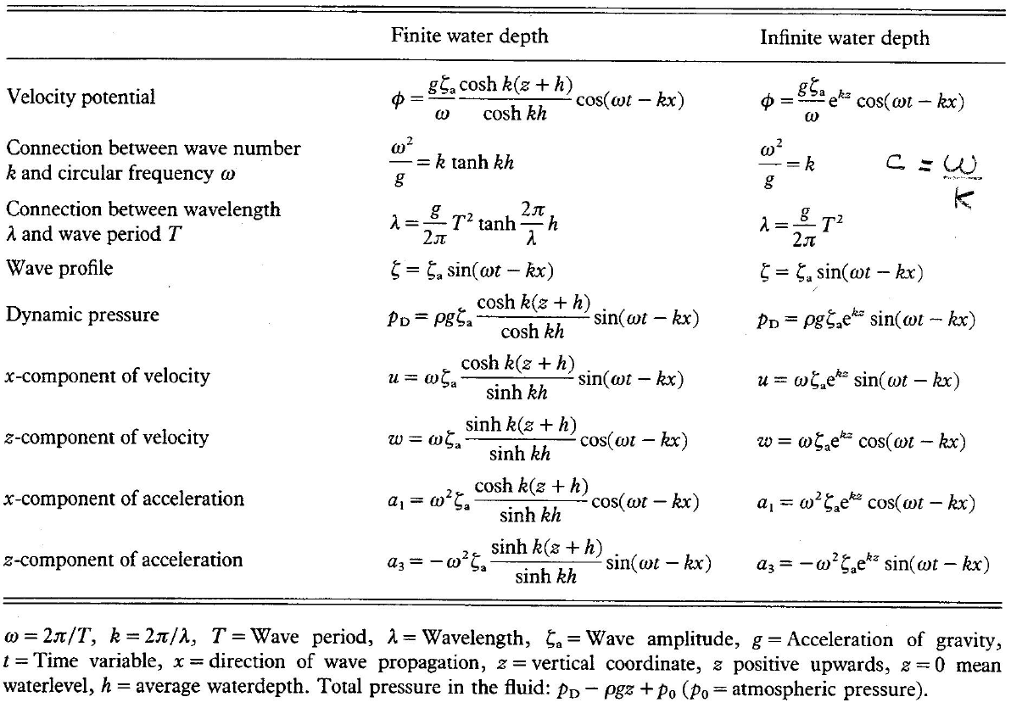
Regular wave formulae (Faltinsen, 1990)
One-day Tutorial, CAMS'07, Bol, Croatia

Slide 21
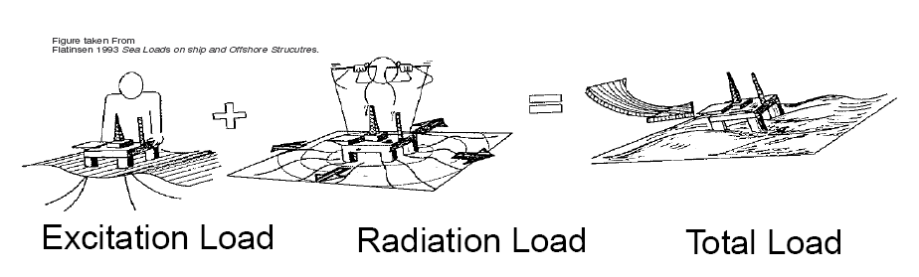
Potential theory for ships in waves
The fluid forces are due to variations in pressure on the surface of the hull.
It is normally assumed that the forces (pressure) can be made of different components
One-day Tutorial, CAMS'07, Bol, Croatia

Slide 22
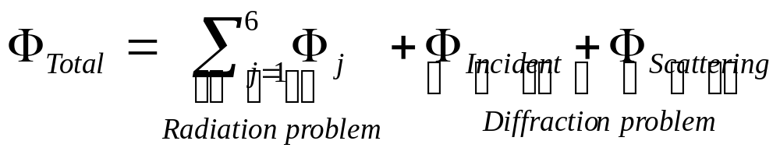

Potential theory for ships in waves
Under linearity assumptions, the hydrodynamic problem is dealt as 2 separate problems and the solutions then added:
Radiation problem: the ship is forced to oscillate in calm water.
Diffraction problem: the ship is restrained from moving in the presence of a wave field.
Potentials:
- due to the motion in the j-th DOF.
One-day Tutorial, CAMS'07, Bol, Croatia

Slide 23
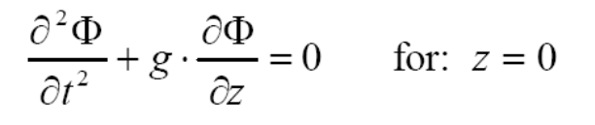
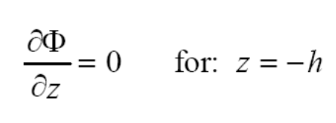
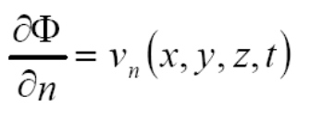

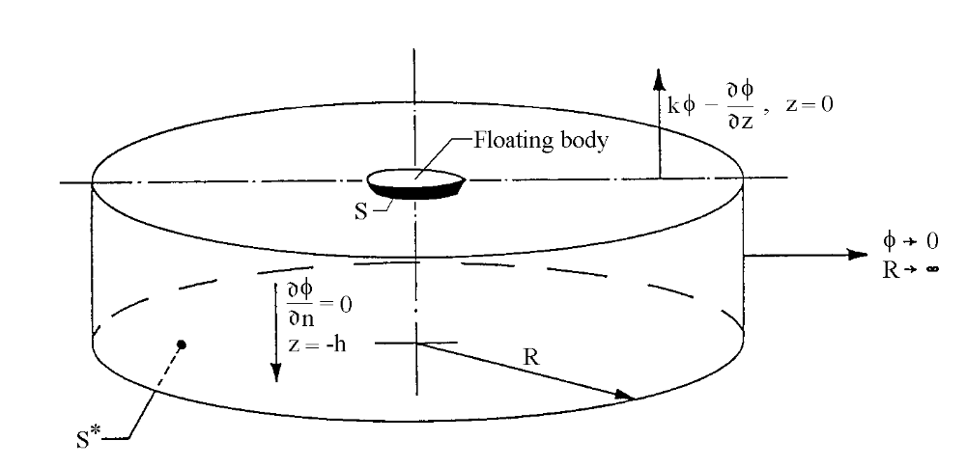
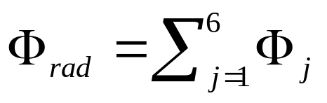
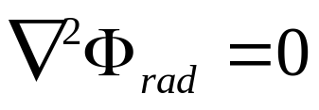
Radiation potential
Boundary conditions:
free surface condition (dynamic+kinematic conditions)
sea bed condition
dynamic body condition
radiation condition
One-day Tutorial, CAMS'07, Bol, Croatia

Slide 24
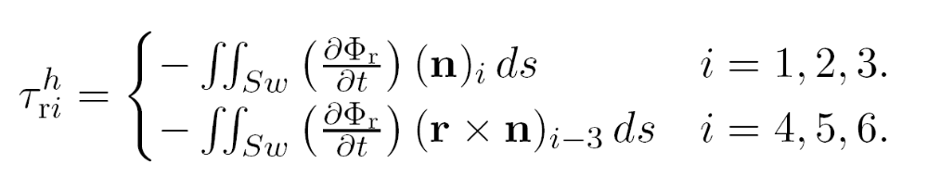
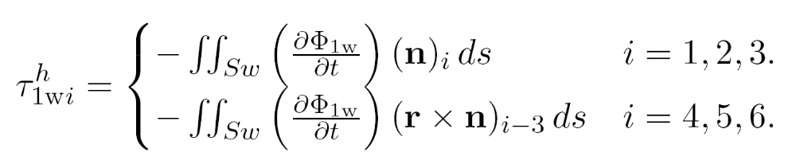
Computing forces
Forces and moments are obtained by integrating the pressure over the average wetted surface Sw:
Notation: i-th component
Radiation forces and moments:
DOF:
1-surge
2-sway
3-heave
4-roll
5-pitch
6-yaw
Excitation forces (due to incident and scattered potentials) and moments:
One-day Tutorial, CAMS'07, Bol, Croatia

Slide 25
References
Faltinsen, O.M. (1990) Sea Loads on Ships and Ocean Structures. Cambridge University Press.
Journée, J.M.J. and W.W. Massie (2001) Offshore Hydromechanics. Lecture notes on offshore hydromechanics for Offshore Technology students, code OT4620. (http://www.ocp.tudelft.nl/mt/journee/)
One-day Tutorial, CAMS'07, Bol, Croatia

